Slide 1
23EC2210R/A/E- Network protocols and Security
CO-1 Session-9 Error Correction techniques

Slide 2
AIM OF THE SESSION
The aim for error correction in networks is to ensure the integrity and reliability of data transmission by detecting and correcting errors that may occur during transmission.
INSTRUCTIONAL OBJECTIVES
Ensure learners be able to apply error detection methods like parity, cyclic redundancy check, check sum while understanding the pros and cons in each method.
LEARNING OUTCOMES
Able to apply error Correction methods
Understand the pros and cons of each method in detail which enables them to design new techniques in their research.

Slide 3
AGENDA
Error Correction
Hamming Code Techniques-Redundancy bits
Hamming Code Technique-Redundancy bit positions
Hamming Code Technique-Computing R bits
Hamming Distance

Slide 4
Error Correction
Error correction can be handled in two ways
when an error is discovered, the receiver can have the sender retransmit the entire data unit.
receiver can use an error-correcting code, which automatically corrects certain errors.

Slide 5
Error Correction
Redundancy Bits
To calculate the number of redundancy bits (R) it is required to understand the given number of data bit (M) for which error correction method can applied.
If the total number of bits in a transmittable unit is m+r, then r must be able to indicate at least m+r+1 different states
2^{r} ≥ m + r + 1.
Ex: Assume data word as 1101
For value of m is 4 (ASCII), the smallest r value that can satisfy this equation is 3
2⁴ ≥ 7 + 4 + 1
for example data bits m=4 and redundancy bits r=3 total bits or code word=7 bits

Slide 6
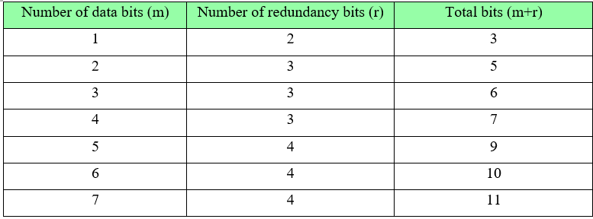
Hamming Code technique- Redundancy bits

Slide 7
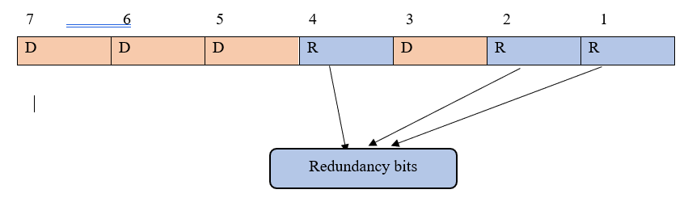
Hamming Code technique- - Redundancy(R) bit Positions

Slide 8
Hamming Code technique- Computing R bits
each r bit is the Vertical redundancy check bit for one combination of data bits
r₁ = bits 1, 3, 5, 7
r₂ = bits 2, 3, 6, 7
r₄ = bits 4, 5, 6, 7

Slide 9
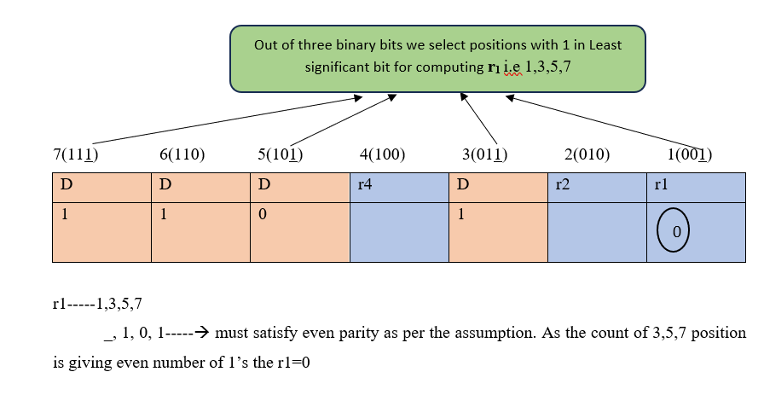
Hamming Code technique- Computing R bits

Slide 10
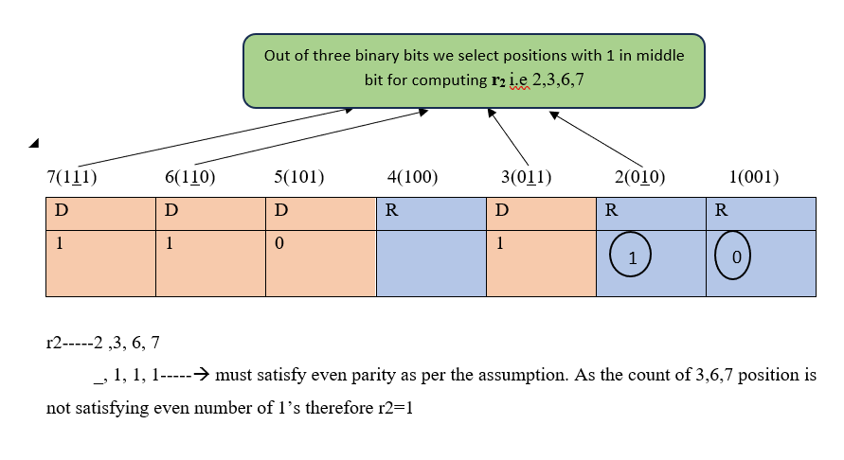
Hamming Code technique- Computing R bits

Slide 11
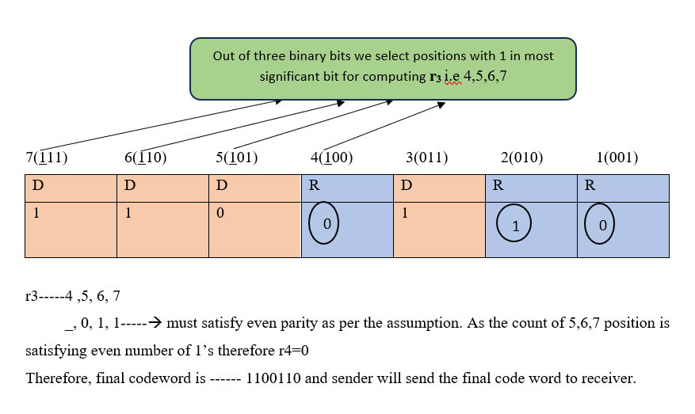
Hamming Code technique- Computing R bits

Slide 12
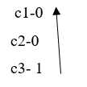
Hamming Code technique- Computing R bits
Receiver repeats the same process on the final codeword and verifies for the error
Applying the same process at the receiver side and computes c1, c2, c4 similar to the prosecc of computing r1,r2, r4. If it gets c1,c2, c3 as 0,0,0 it means that there is no error.
For eg.: If
read it from c3 to c1----100—4 in decimal.
with this it makes clear that position 4 is erroneous and may change the bit value accordingly.

Slide 13
Hamming Distance
Hamming distance is used to identify the number of bit changes in the given code words. Hamming distance is computed by applying xor operation between the two code words.
Eg: Codeword-1------- 1100110
Codeword-2------- 1110100
Hamming Distance(xor)-- 0010010
Therefore Hamming Distance is --2

Slide 14
SELF-ASSESSMENT QUESTIONS
Explain the Purpose of Hamming code in error detection and correction.
Explain the concept of Parity in Hamming code
Does Hamming code detect and correct Single bit errors
Can Hamming code detect and correct multiple bit errors
List and explain the limitations of Hamming code
How many parity bits are required in hamming code with data word of length 11
Calculate the hamming code with data word 1011 using even parity
Compare and contrast Hamming code with other error detection techniques like CRC, checksum.
Explain the purpose of error correction technique in data communication

Slide 15
REFERENCES FOR FURTHER LEARNING OF THE SESSION
References of books, sites, links
Text Books
Data Communications and Networking (3rd Ed.) “–B. A. Ferouzan – TMH
Computer Networks (4th Ed.)”, A. S. Tanenbaum – – Pearson Education/PHI
Reference Text books
Data and Computer Communications (5th Ed.)” – W. Stallings – PHI/ Pearson Education
Network for Computer Scientists & Engineers, Zheng & Akhtar, OUP
Data & Computer Communication, Black, PHI
Data Communication & Network, Miller, Vikas
Web References
Kurose and Rose – “Computer Networking -A top down approach featuring the internet”– Pearson Education
“Communication Networks” – Leon, Garica, Widjaja TMH
“Internetworking with TCP/IP, Comer – vol. 1, 2, 3(4th Ed.)” – Pearson Education/PHI
https://www.tutorialspoint.com/what-is-closed-loop-congestion-control/
https://www.geeksforgeeks.org/congestion-control-techniques-in-computer-networks/3.

Slide 16

THANK YOU
Team – Networks Protocols & Security

